Slide 1
TEMPERATURE SENSOR

Slide 2
What is Temperature Sensor?
A temperature sensor is an electronic device that measures the temperature of its environment and converts the input data into electronic data to record, monitor, or signal temperature changes.
There are many different types of temperature sensors. Some temperature sensors require direct contact with the physical object that is being monitored (contact temperature sensors), while others indirectly measure the temperature of an object (non-contact temperature sensors).

Slide 3
Non-contact temperature sensors are usually infrared (IR) sensors. They remotely detect the IR energy emitted by an object and send a signal to a calibrated electronic circuit that determines the object's temperature.
Among the contact temperature sensors are thermocouples and thermistors.

Slide 4
Classification
Temperature sensor are basically classified into two types
Non Contact Temperature Sensors: These temperature sensors use convection & radiation to monitor temperature
Contact Temperature Sensors: Contact temperature sensors are then further sub divided into three type
Electro-Mechanical(Thermocouples).
Resistive Resistance Temperature Detectors (RTD).
Semiconductor based. (LM35, DS1820 etc).

Slide 5
ThermoCouple
A thermocouple is comprised of two conductors, each made of a different type of metal, that are joined at an end to form a junction. When the junction is exposed to heat, a voltage is generated that directly corresponds to the temperature input. This happens on account of the phenomena called the thermoelectric effect. Thermocouples are generally inexpensive, as their design and materials are simple.

Slide 6
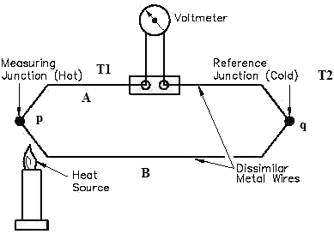
Thermocouple

Slide 7
Thermistor
The other type of contact temperature sensor is called a thermistor. In thermistors, resistance decreases as temperature increases. There are two main types of thermistors: Negative Temperature Coefficient (NTC) and Positive Temperature Coefficient (PTC). Thermistors are more precise than thermocouples (capable of measuring within 0.05-1.5 degrees Celsius), and they are made of ceramics or polymers. Resistance Temperature Detectors (RTD) are essentially the metal counterpart of thermistors, and they are the most precise and expensive type of temperature sensors.

Slide 8
How does Temperature sensor works?
The basic principle of working of the temperature sensors is the voltage across the diode terminals.
If the voltage increases, the temperature also rises, followed by a voltage drop between the transistor terminals of base and emitter in a diode.

Slide 9
Contact and non-contact temperature sensors are further divided into:
Thermostats
Thermistors
Thermocouples
Negative Temperature Coefficient (NTC) Thermistor

Slide 10
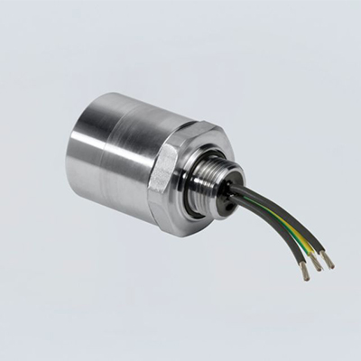
Thermostats
A thermostat is a contact type temperature sensor consisting of a bi-metallic strip made up of two dissimilar metals such as aluminium, copper, nickel, or tungsten.
The difference in the coefficient of linear expansion of both the metals causes them to produce a mechanical bending movement when it’s subjected to heat.

Slide 11
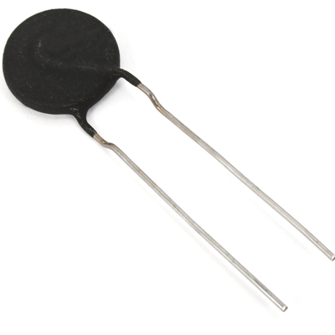
Thermistors
Thermistors or thermally sensitive resistors are the ones that change their physical appearance when subjected to change in the temperature.
The thermistors are made up of ceramic material such as oxides of nickel, manganese or cobalt coated in glass which allows them to deform easily.
Most of the thermistors have a negative temperature coefficient (NTC) which means their resistance decreases with an increase in the temperature.

